Slide 1

Lesson 1: Homework Review

Slide 2
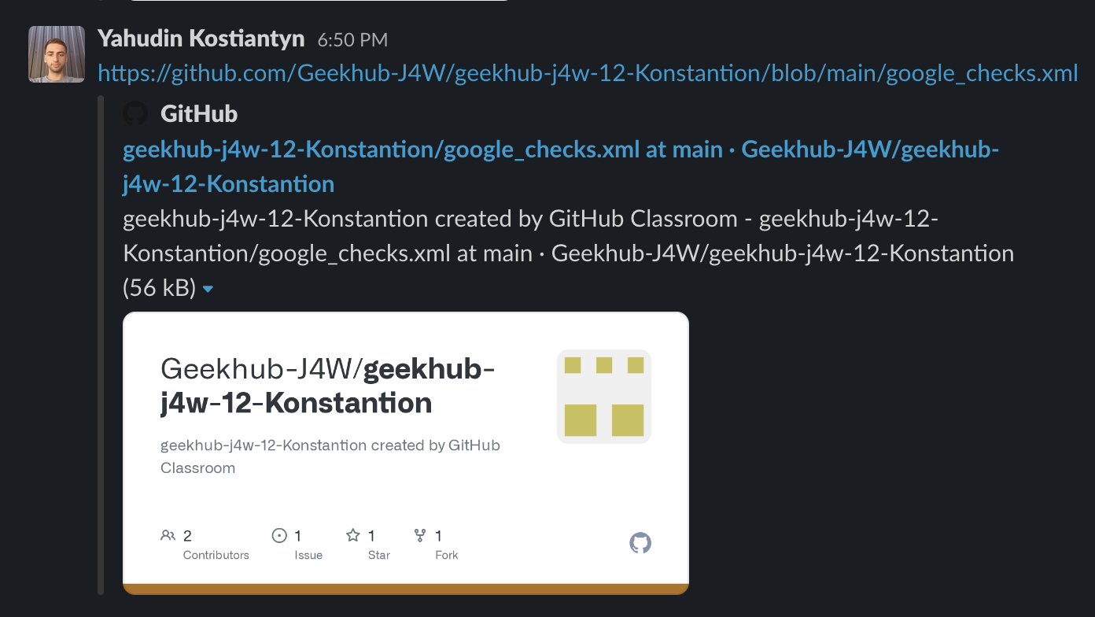
Make repositories private

Slide 3
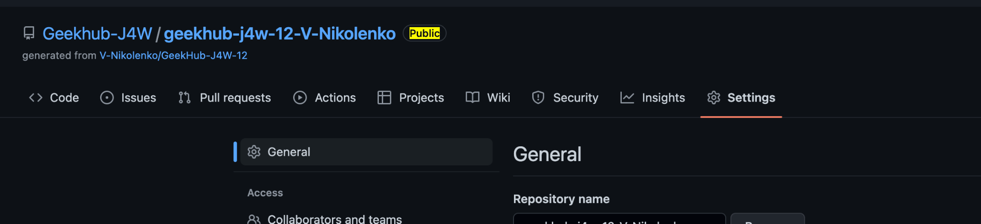
Make repositories private

Slide 4
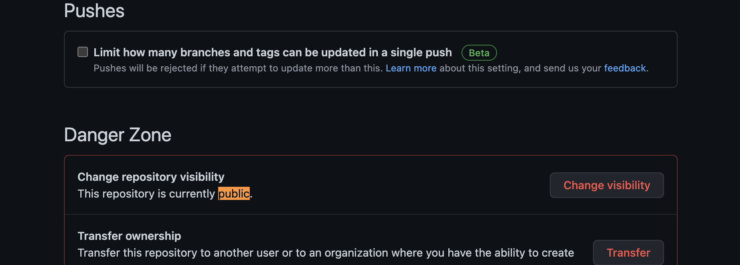
Private Repository

Slide 5
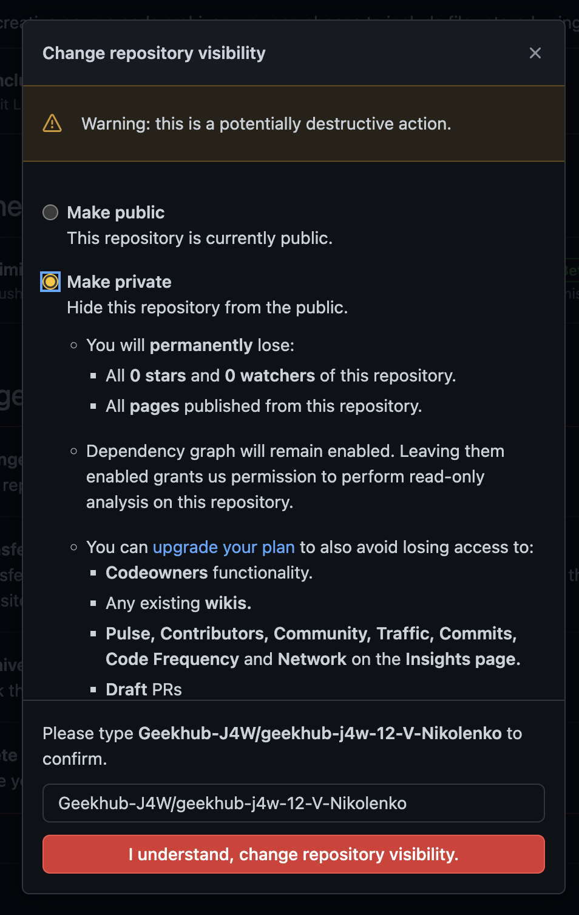
Private Repository

Slide 6
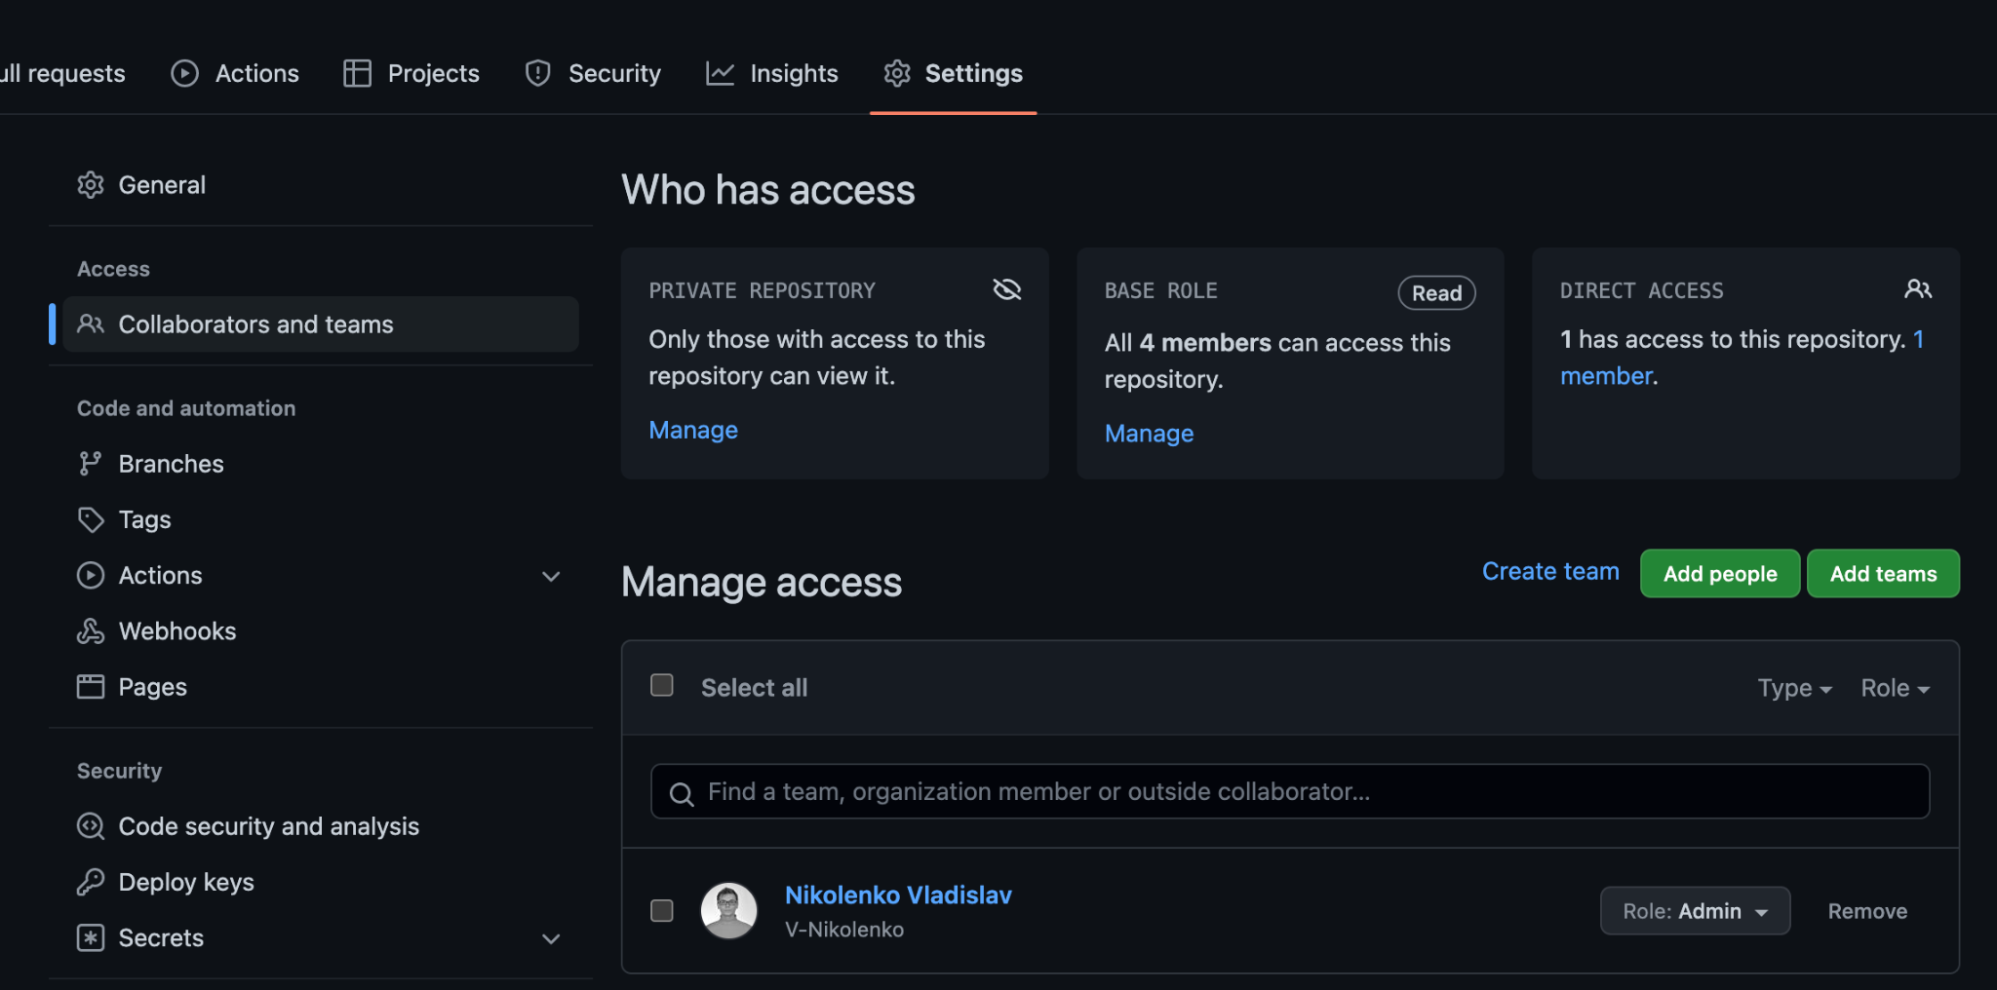
Private Repository

Slide 7
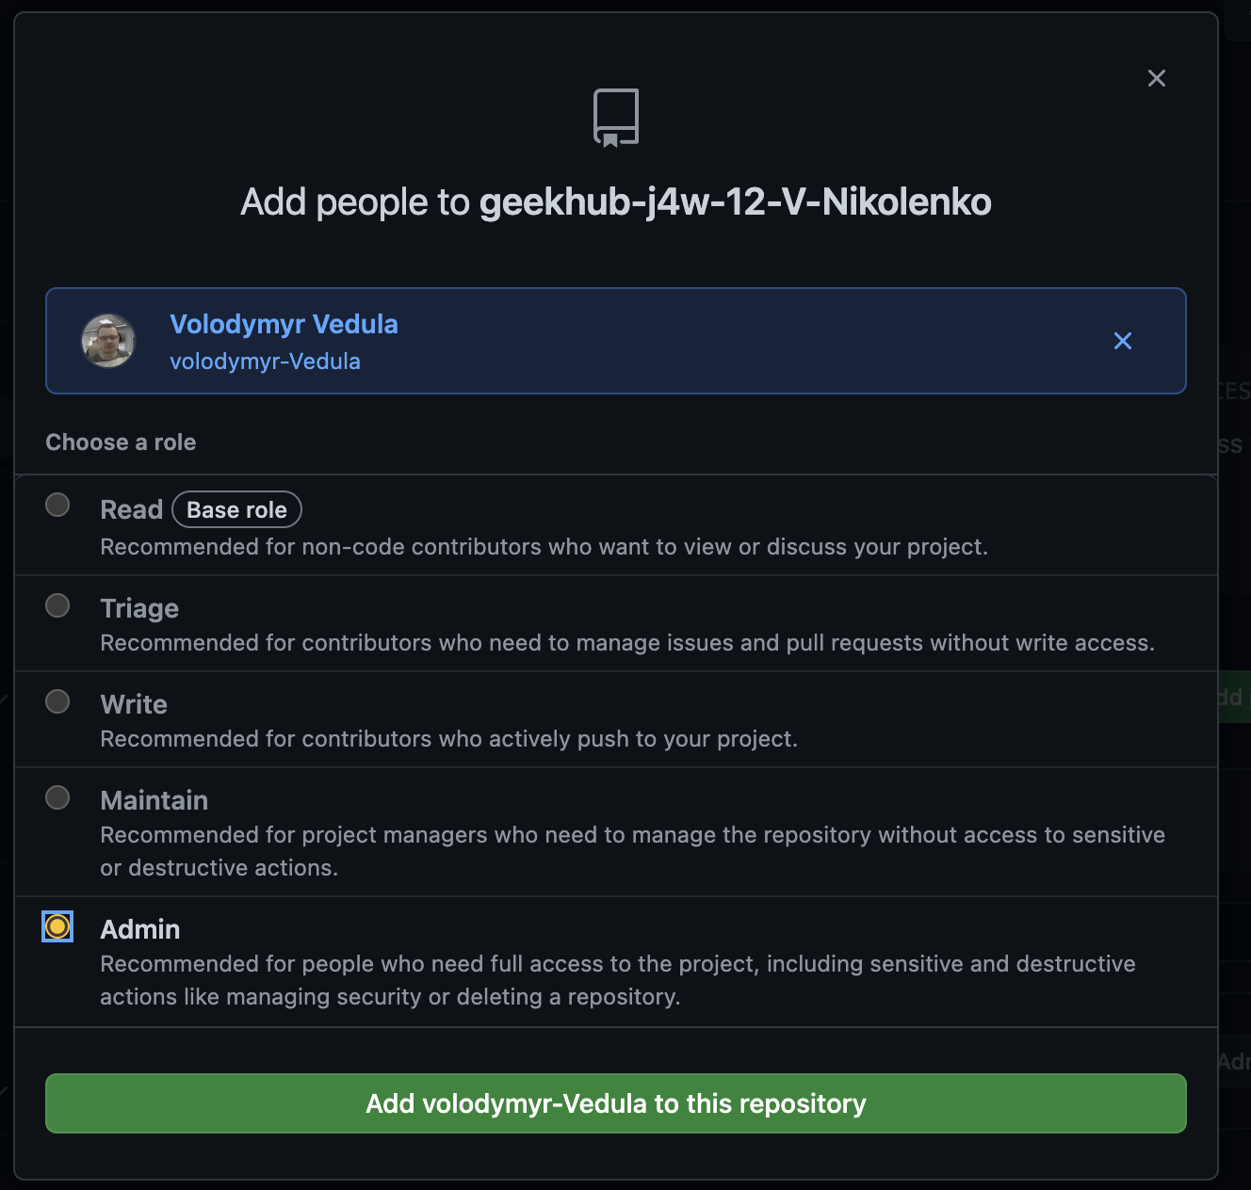
Private Repository
Make repositories private
Add admin roles to the mentors
volodymyr-Vedula
cherniakb
V-Nikolenko

Slide 8
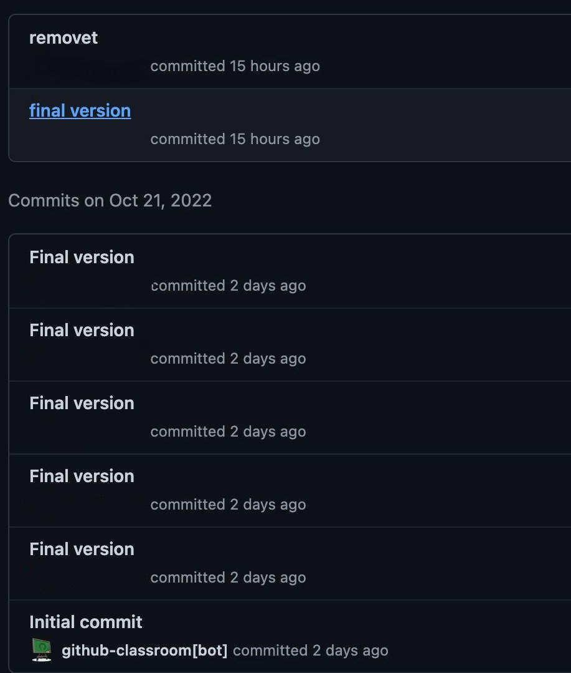
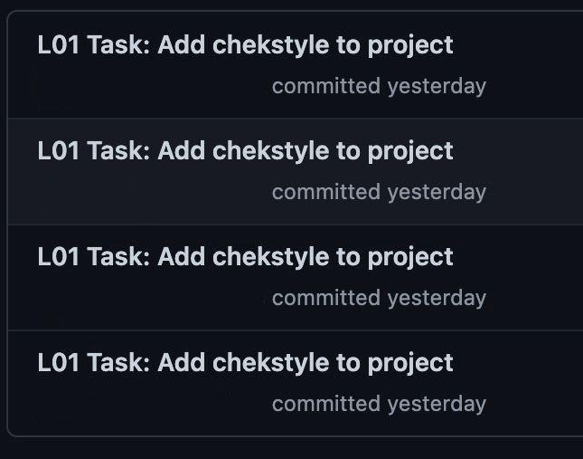
Make commits helpful

Slide 9
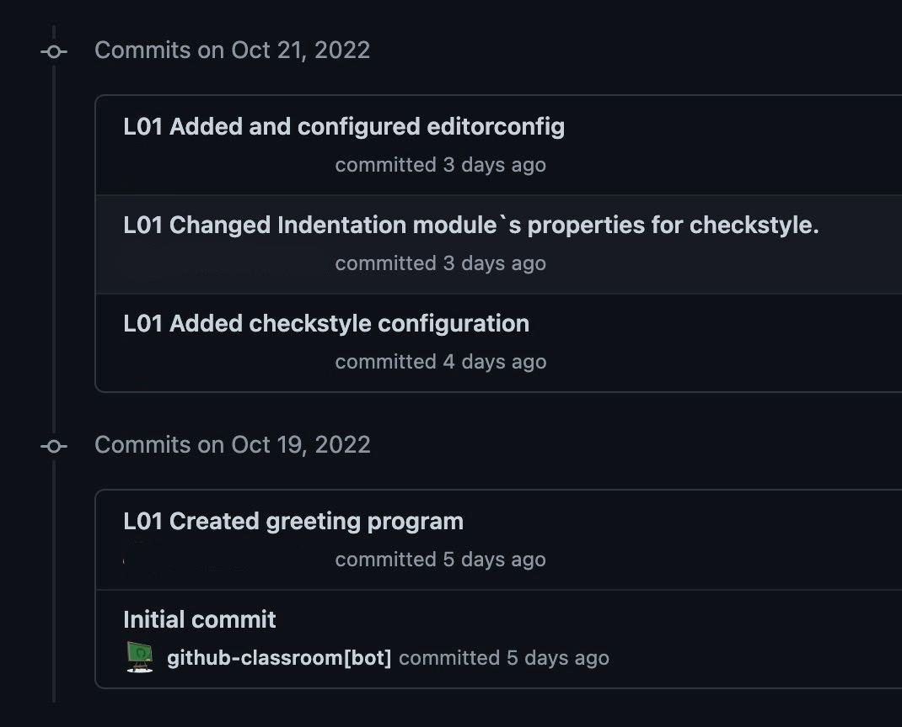
Make commits helpful

Slide 10
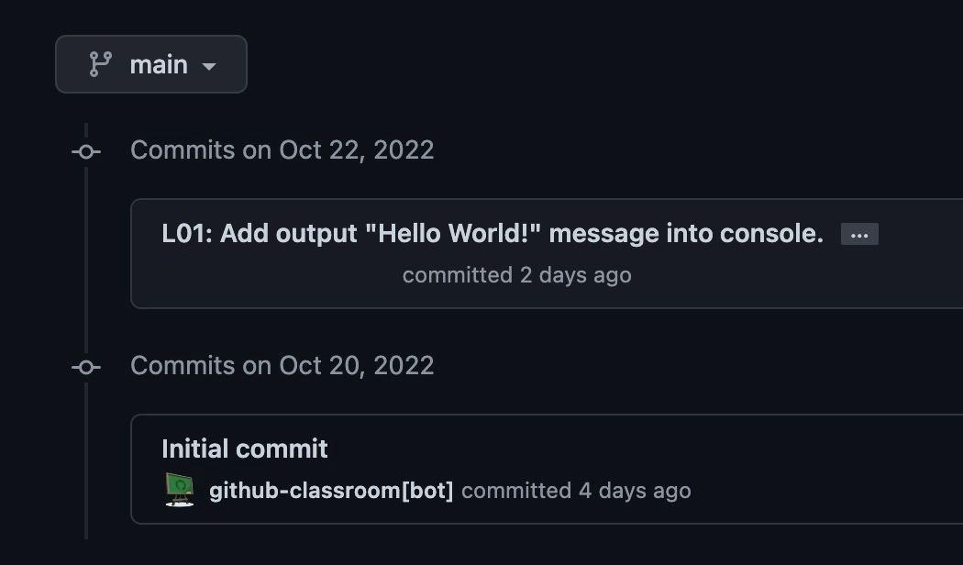
Make Atomic Git Commits

Slide 11
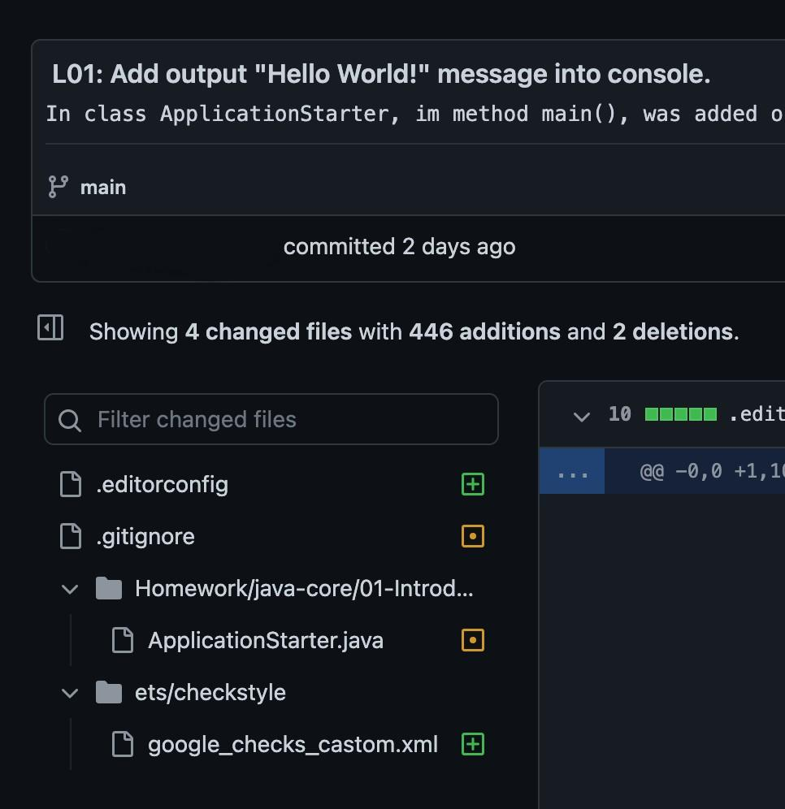
Make Atomic Git Commits

Slide 12
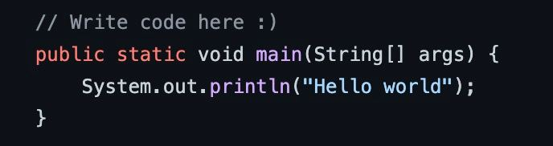
Remove useless comments\code

Slide 13
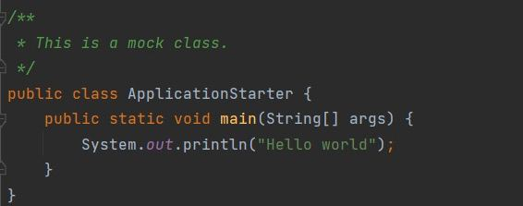
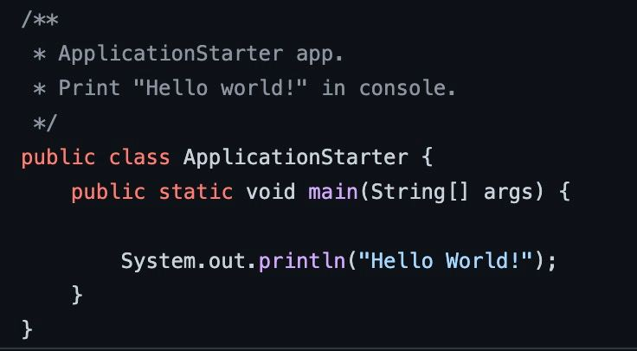
Improve checkstyle supressions

Slide 14
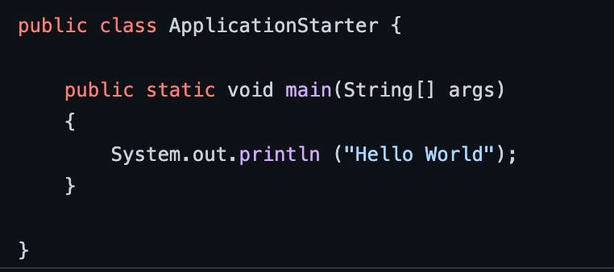
Follow code conventions

Slide 15
Follow geekhub rules!

Slide 16
That's all!
Find us in Slack:
@Bohdan Cherniak
@Vladyslav Nikolenko
@Volodymyr Vedula

